Slide 1
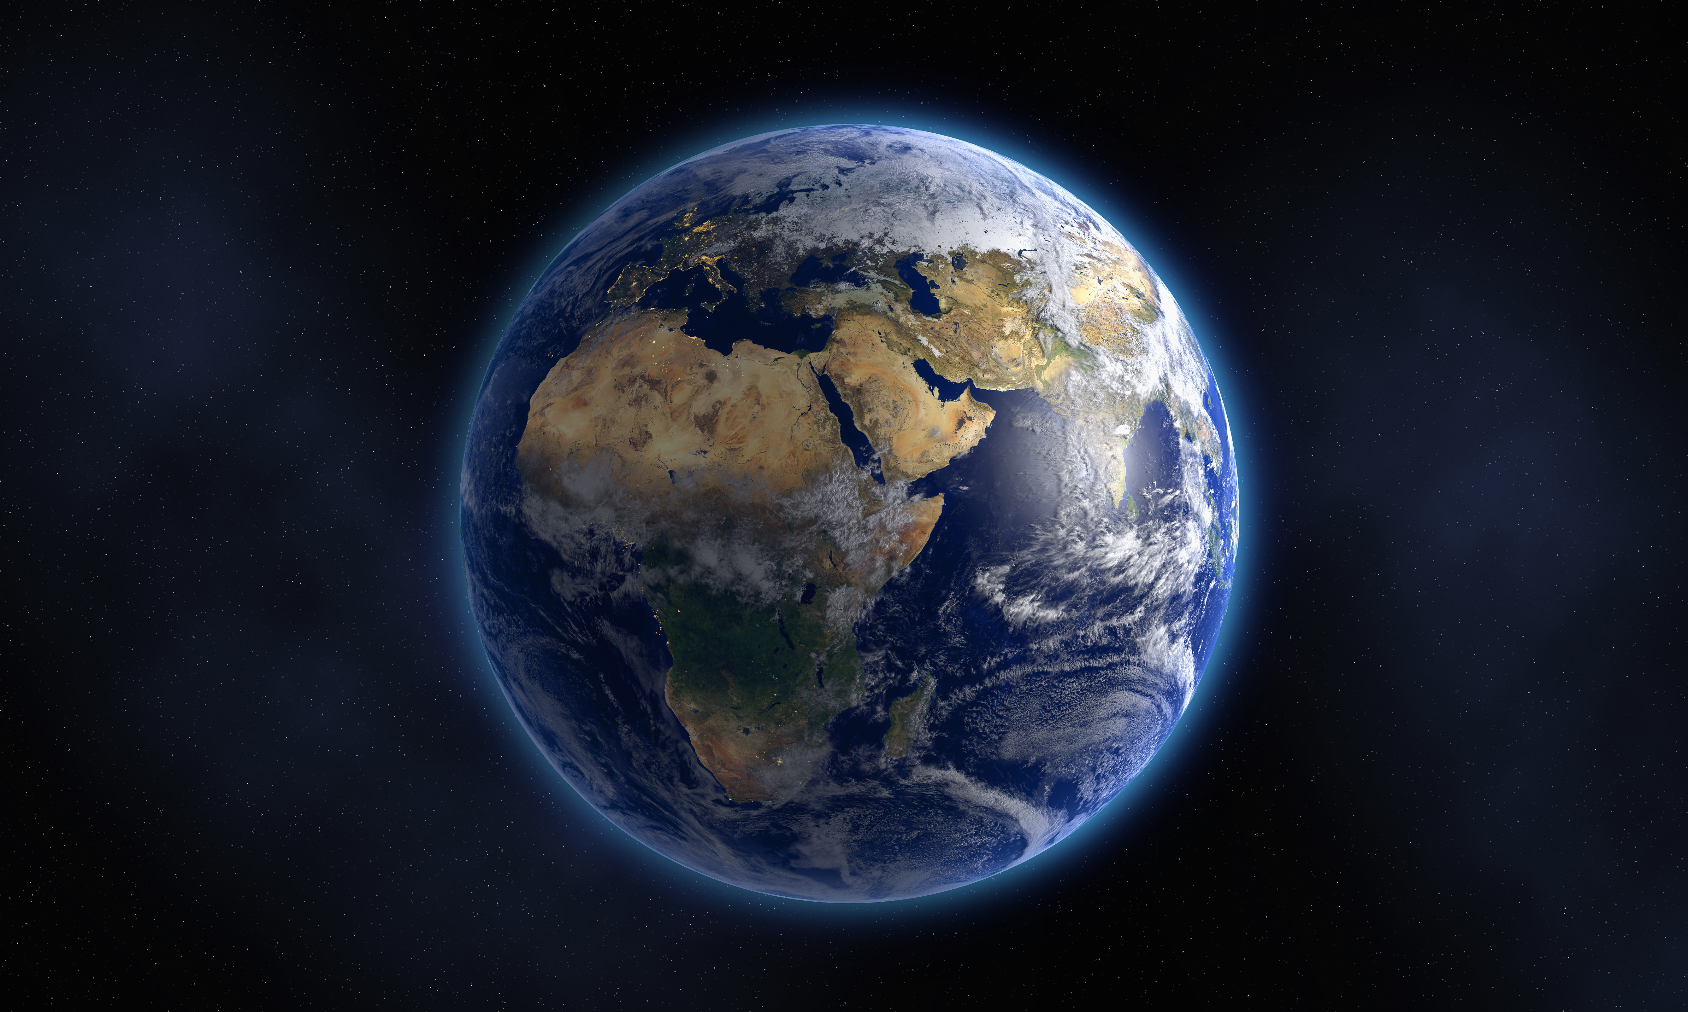
ASTROrPHEuS “Experience SPACE IMAGEs like Never Before”
Murphy Ownbey, Mo Mirsodikov, and Ethan Wells
Background – NASA Researchers have used “sonification” to experience 2D Space data and in ways like never before.
Objective – “Develop a way to explore 3D data that merges visual and audio elements”

Slide 2
Conceptualization
Goal: Leverage our teams skill sets and industry experience to create a new ways to visualize space data.
Challenge Info/Questions:
Combine 3D data and sound. What 3D data to use?
Team Background: Spatial Technologies andWeb Site Design
Popular Industry Technologies:Point Clouds
Idea Generation:
Web App that creates a point-cloud and audio from an image, and then displays the two together in an interactive environment.

Slide 3
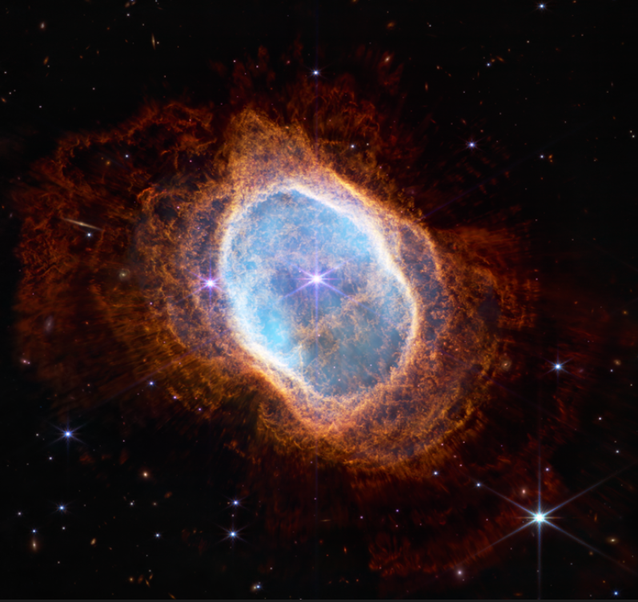
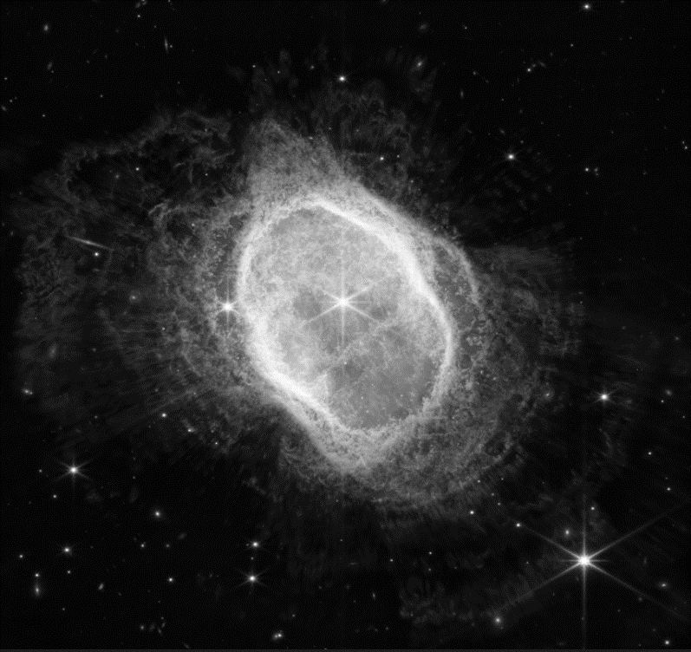
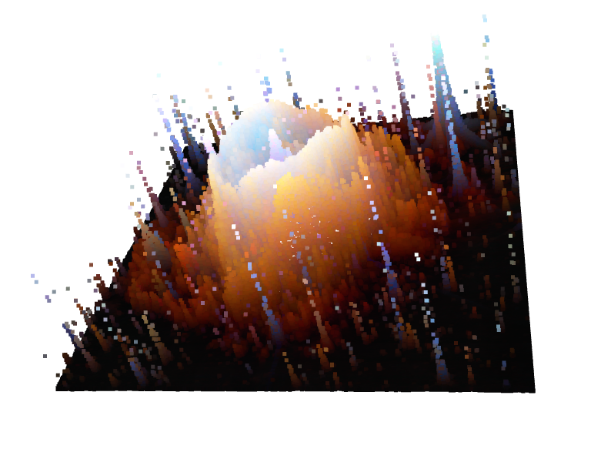
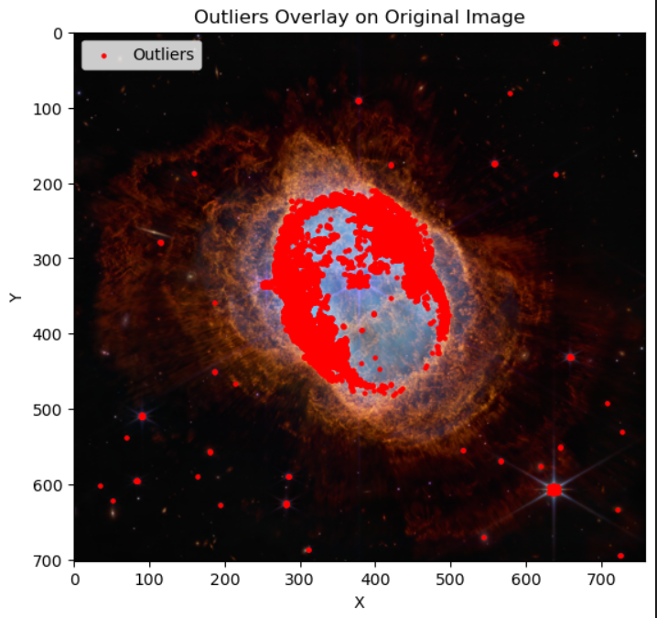
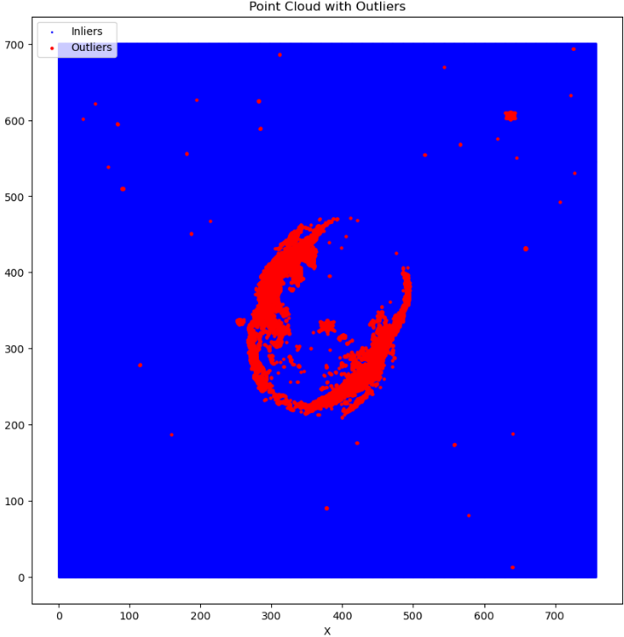
DATA Processing
Read Uploaded Image
Convert to Grayscale
Map the grayscale as the depth/Z value for the point cloud
Dynamically Create Threshold → Detect Outliers based on Threshold
Sonification Cont.

Slide 4
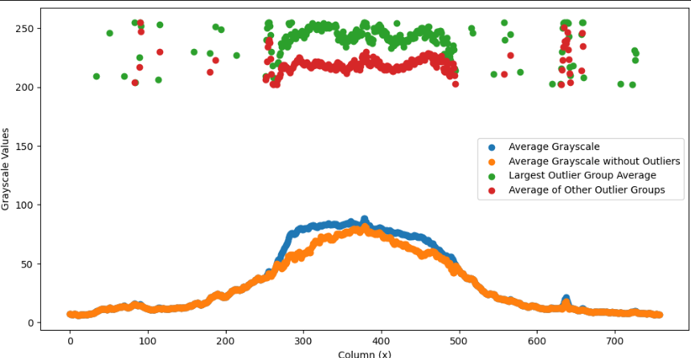
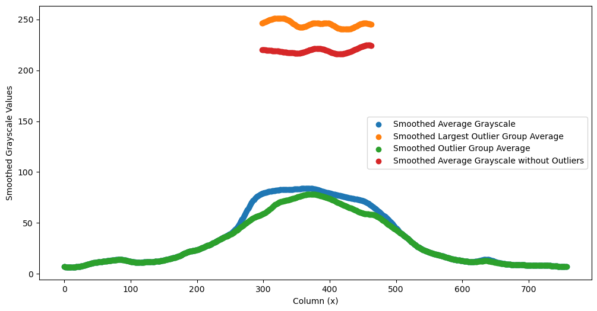
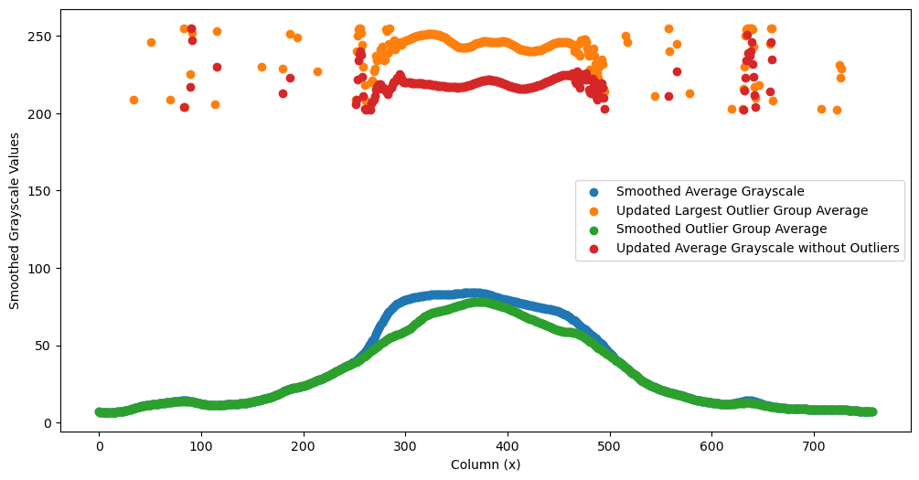
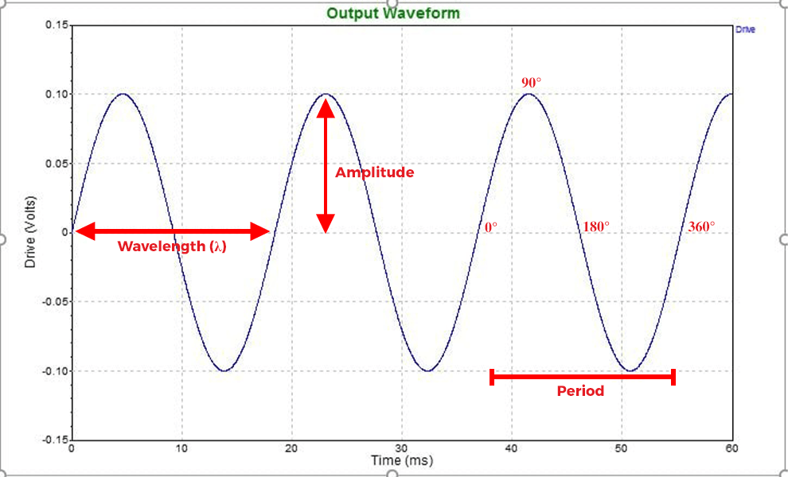

Sonification Cont.
Create Mapping Function based on # of Outliers
Clean Data using Gaussian Filtering
Superimpose Data for Data Retention
Generate Sine Waves and .wav File

Slide 5
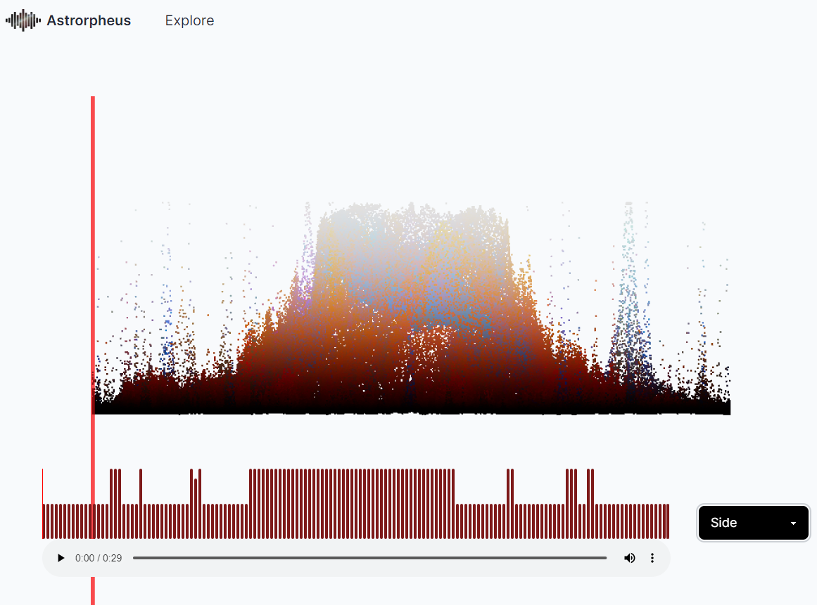
WEB App - Design
Audio Player
Perspective Selector
3D Model Viewer with moving plane to correlate sound played to data in the point cloud.
Explore Page
Upload Image Page

Slide 6
IMPACT - Enriching Space Exploration with Multi-Sensory Data
Enhanced Interpretation:
Converting space images into point clouds and sonification provides a new dimension of understanding, allowing for an in-depth data analysis.
Interactive Visualization:
A moving plane across the point cloud correlated with sonification brings data to life, aiding in identifying key data points.
Novel Perspective:
The 3D viewer provides a unique perspective to explore the data, fostering a deeper comprehension of space images.
Knowledge Expansion:
Both NASA researchers and the community gain a multi-dimensional understanding of space images, potentially leading to new discoveries.

Slide 7
Future - Building a Community of Space Enthusiasts
Social Sharing: Ability to share created visualizations will foster a sense of community and encourages knowledge exchange.
Popular Visualizations: A dedicated page for popular visualizations would provide a platform for learning and insight generation.
Collective Learning: NASA researchers can benefit from diverse inputs, fostering collective space exploration.
Increase in Engagement: Most popular visualizations can provide a benchmark for understanding what aspects of space data intrigue people the most, leading to increased interest and engagement in space science.

